Slide 1
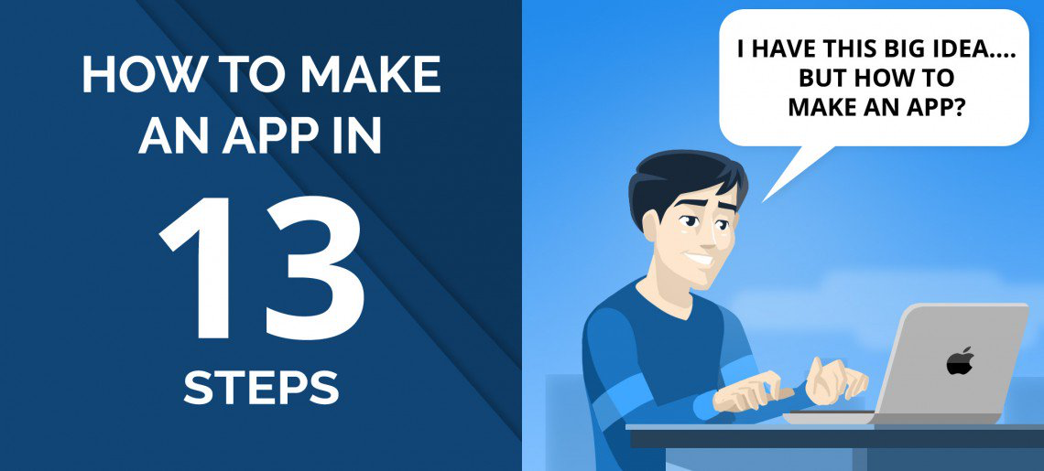
How to make an app?
Real life lessons learned the HARD WAY

Slide 2
Back4app
How to make an app?
Write down your high-level idea
Choose either Android or iOS, but do not develop both at the same time
Wireframe, mockup, and prototype your app
Collect feedback from customers
Create your app backend
Code your app frontend
Create your app landing page
Implement your app analytics dashboard
Optimize your app for SEO
Beta test your app with real users
Publish your app
Promote your app to reach the right users
Improve your app with customer feedback
Read the full article at
https://blog.back4app.com/2019/07/11/how-to-make-an-app/

Slide 3
Back4app
How to make an app?

Slide 4
Back4app
How to make an app?
Don’t start coding right away
Please keep it simple and start with an MVP
Get feedback from customers as early as possible
Read the full article at
https://blog.back4app.com/2019/07/11/how-to-make-an-app/

Slide 5
Back4app
How to make an app?
1. Write down your high-level idea
Use the Business Model Canvas
Buy Startup Owners Manual
Have a budget
Developers vs. Software Development Company
Consumer App x Business App
Research competitors for your app
Read the full article at
https://blog.back4app.com/2019/07/11/how-to-make-an-app/

Slide 6
Back4app
How to make an app?
2. Choose Android or iOS
Android
It has roughly 80% of the user base. Generally speaking, if you want to target a broader user base, you should start with Android. It’s also mainly used in emerging markets like South America and Asia.
iOS
On the other hand, iOS encompasses 20% of the user base. Generally speaking, it’s a better choice to reach more engaged users and with more earning power.
Read the full article at
https://blog.back4app.com/2019/07/11/how-to-make-an-app/

Slide 7
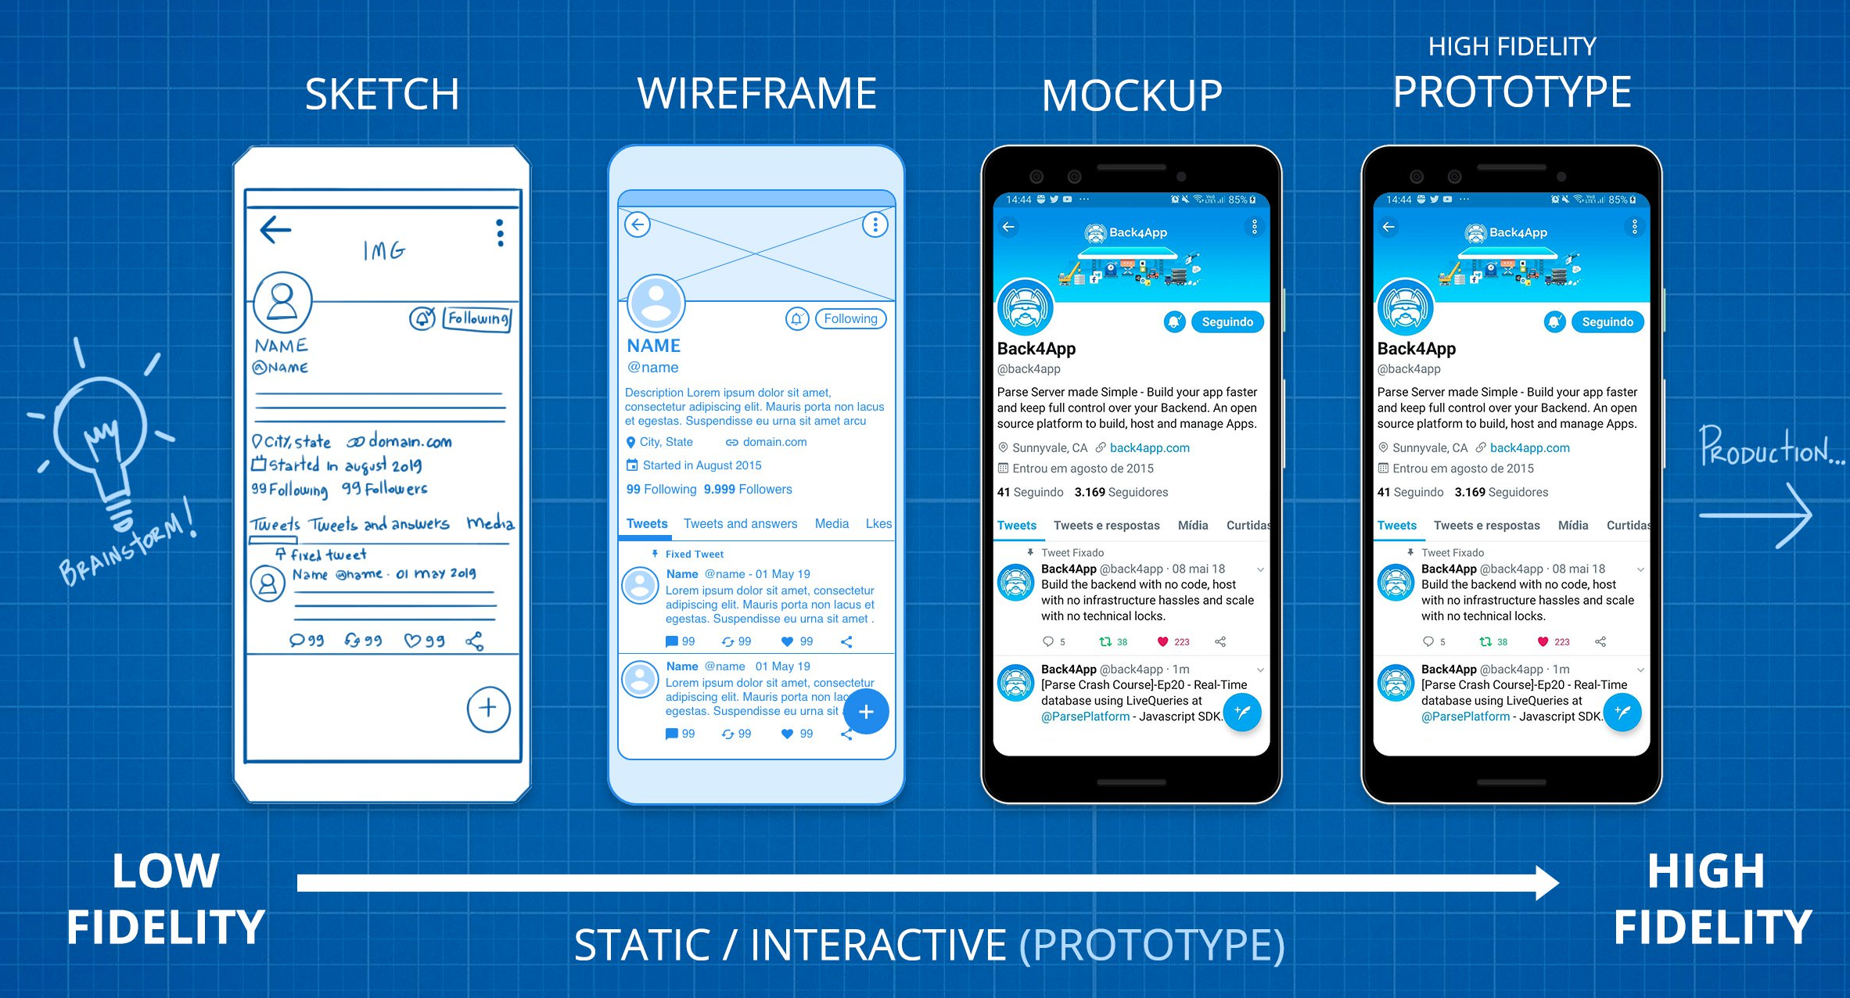
Back4app
How to make an app?
3. Wireframe & Mockup & Prototype
Read the full article at
https://blog.back4app.com/2019/07/11/how-to-make-an-app/

Slide 8
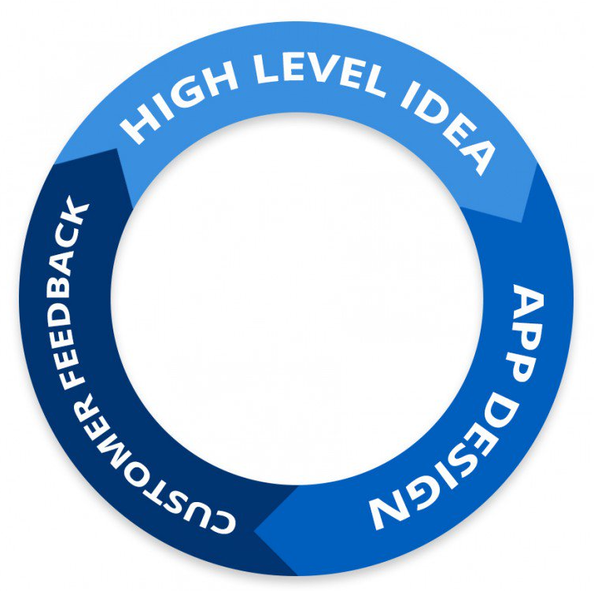
Back4app
How to make an app?
4. Get Customer Feedback
Read the full article at
https://blog.back4app.com/2019/07/11/how-to-make-an-app/

Slide 9
Back4app
How to make an app?
5. Create your App Backend
Use Back4app to speed up development
Make sure you are GDPR compliant
Evaluate custom backend
Read the full article at
https://blog.back4app.com/2019/07/11/how-to-make-an-app/

Slide 10
Back4app
How to make an app?
6. Create your App Frontend
Native Apps – Best performance, more expensive
Web Apps – Cheaper, worst UX
Hybrid Apps – Mix of Native and Web
Read the full article at
https://blog.back4app.com/2019/07/11/how-to-make-an-app/

Slide 11
Back4app
How to make an app?
7. Create your App Landing Page
Producing an app LP will enable you to target your audience, offer them something of value, and transform a higher percentage of your visitors into application downloads, while also obtaining data about who they are and what they’ve converted on. Landing pages are also relevant because they increase your credibility and strengthen your brand. There are lots of tools that can help you to create a landing page.
Read the full article at
https://blog.back4app.com/2019/07/11/how-to-make-an-app/

Slide 12
Back4app
How to make an app?
8. Mobile Analytics
If You Can’t Measure It, You Can’t Improve It. So, you have to monitor your mobile app! Mobile app analytics is indispensable for several reasons. It provides you clarity about how customers are using your application, which components of the app they interact with, and what actions they do within the app.
Read the full article at
https://blog.back4app.com/2019/07/11/how-to-make-an-app/

Slide 13
Back4app
How to make an app?
9. Test your App
Functional Testing – Does the app work as expected?
Usability Testing – Is your app easy to use?
User Interface Testing – Check elements of the screen
Performance Testing – Is your application stable and fast?
Compatibility Testing – Screen resolution, orientation, hardware, etc
Read the full article at
https://blog.back4app.com/2019/07/11/how-to-make-an-app/

Slide 14
Back4app
How to make an app?
10. Optimize your app SEO
Most people miss this step! There is too much competition in the app stores, and users need to find you quickly. An excellent way to do that is by optimizing your app and having a good SEO (ASO) ranking.
Read the full article at
https://blog.back4app.com/2019/07/11/how-to-make-an-app/

Slide 15
Back4app
How to make an app?
11. Launch your App
Legal Aspects – Terms of Use & Privacy Policy
Publish the App – App Store vs Google Play
Read the full article at
https://blog.back4app.com/2019/07/11/how-to-make-an-app/

Slide 16
Back4app
How to make an app?
12. Promote your App
Start a blog
Use LinkedIn, Facebook, Twitter, and other social media
Create a video for your app
Answer questions on Quora and Reddit
Create a Slideshare presentation
Post a job on Indeed
Read the full article at
https://blog.back4app.com/2019/07/11/how-to-make-an-app/

Slide 17
Back4app
How to make an app?
13. Get customer feedback
This step never ends! The more data and understanding of your users you have, the better decisions you can take for the future of your app. There is no magic pill, and to increase your app usage, you will need to work hard and have a regular monitoring routine! Getting customer feedback has to be a part of your daily routine! Let’s suppose you invest 1 hour per day getting customer feedback, imagine how much you can learn after 365 days. It’s essential to obtain quantitative and qualitative data about your users.
Read the full article at
https://blog.back4app.com/2019/07/11/how-to-make-an-app/

Slide 18
Back4app
How to make an app?
Conclusion
Bringing your app idea to life, it’s not an easy task! You need to organize yourself, allocate time, and financial resources to start a mobile app project. Before coding the app, please make sure you create high-level specifications, design the application, and talk to customers. As soon as you are comfortable that there is market demand for your product, choose one operating system, and start developing your MVP. Test your app with real users and optimize your SEO before launching. Once you are online, advertise your product, and interact with your users as much as you can. The better you understand them, the more successful your app will be.
Read the full article at
https://blog.back4app.com/2019/07/11/how-to-make-an-app/

